Slide 1
SEEKING GOD WITH THE PSALTER
Majesty & Weakness
Palmetto Church of Christ (Summer 2020)

Slide 2
YOU ARE ENTHRONED AMONG THE PRAISES OF ISRAEL
Why do we praise God?
Psalm 22.3

Slide 3
אֲדֹנָי שְׂפָתַי תִּפְתָּח
ETERNAL GOD, OPEN MY LIPS THAT MY MOUTH MAY DECLARE YOUR PRAISE!
Why do we praise God?
Psalm 51.15
וּפִי יַגִּיד תְּהִלָּתֶךָ.

Slide 4
O LORD OUR LORD, HOW MAJESTIC IS YOUR NAME IN ALL THE EARTH?
Why do we praise God?
Psalm 8.1, 9

Slide 5
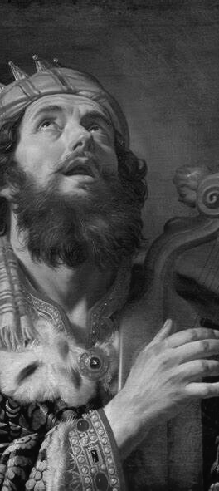
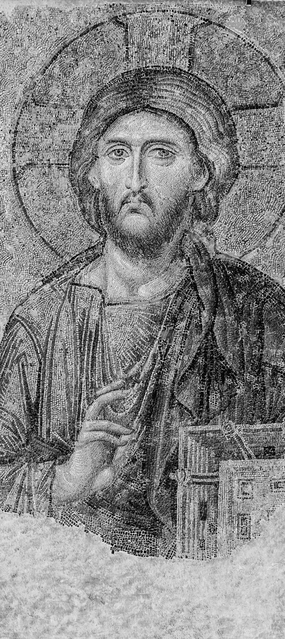
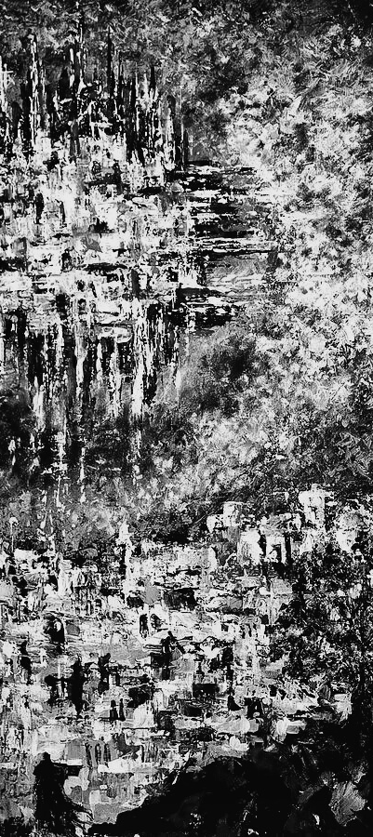
HOW TO LIVE PSALM 8
PRAISE GOD

Slide 6
OUT OF THE MOUTHS OF BABIES AND INFANTS, YOU HAVE ESTABLISHED STRENGTH BECAUSE OF YOUR FOES, TO STILL THE ENEMY AND THE AVENGER
YOU HAVE SET YOUR GLORY ABOUT THE HEAVENS!
Why do we praise God?
Psalm 8.1b
Psalm 8.2

Slide 7
YES, HAVE YOU NEVER READ, "OUT OF THE MOUTHS OF INFANTS AND NURSING BABIES YOU HAVE PREPARED PRAISE"?
OUT OF THE MOUTHS OF BABIES AND INFANTS, YOU HAVE ESTABLISHED STRENGTH BECAUSE OF YOUR FOES, TO STILL THE ENEMY AND THE AVENGER
Why do we praise God?
Matthew 21.1–5, 15–16
Psalm 8.2

Slide 8
HOW TO LIVE PSALM 8
PRAISE GOD
BE INFANTS

Slide 9
YET YOU HAVE MADE HIM A LITTLE LOWER THAN HEAVENLY BEINGS, AND CROWNED HIM WITH GLORY AND HONOR, AND GIVEN HIM DOMINION
WHAT IS MAN THAT YOU ARE MINDFUL OF HIM? MORTAL MAN, THAT YOU CARE FOR HIM?
Why do we praise God?
Psalm 8.4
Psalm 8.5–6

Slide 10
FOR BY A MAN CAME DEATH, SO BY A MAN CAME RESURRECTION OF THE DEAD. FOR IN ADAM ALL DIE AND IN CHRIST ALL ARE MADE ALIVE
WHAT IS MAN THAT YOU ARE MINDFUL OF HIM? MORTAL MAN, THAT YOU CARE FOR HIM?
Why do we praise God?
Psalm 8.4
1 Cor 15.21–28

Slide 11
HOW TO LIVE PSALM 8
BE INFANTS
PRAISE GOD
BE INFANTS
DIE TO SELF
PRAISE GOD
DIE TO SELF

