Slide 1
SEEKING GOD WITH THE PSALTER
I Shall Not Want
Palmetto Church of Christ (Summer 2020)

Slide 2
Lament
Trust
Trust
Thanksgiving

Slide 3
HE MAKES ME LIE DOWN IN GREEN PASTURES. HE LEADS ME BESIDE STILL WATERS. HE RESTORES MY SOUL.
The Lord is my shepherd, I shall not want
HE LEADS ME
IN PATHS OF RIGHTEOUSNESS FOR HIS
NAME'S SAKE.
Psalm 23.3b
Psalm 23.2–3

Slide 4
EVEN THOUGH I WALK THROUGH THE VALLEY OF THE SHADOW OF DEATH, I WILL FEAR NO EVIL
FOR YOU ARE WITH ME.
YOUR ROD AND YOUR STAFF, THEY COMFORT ME.
The Lord is my shepherd,
I shall not want
Psalm 23.4b
Psalm 23.4a

Slide 5
SURELY, GOODNESS AND MERCY SHALL FOLLOW ME ALL THE DAYS OF MY LIFE, AND I SHALL DWELL IN THE HOUSE OF THE LORD FOREVER
YOU PREPARE A TABLE BEFORE ME IN THE PRESENCE OF MY ENEMIES, YOU ANOINT MY HEAD WITH OIL; MY CUP OVERFLOWS
The Lord is my host,
I shall not want
Psalm 23.5
Psalm 23.6

Slide 6
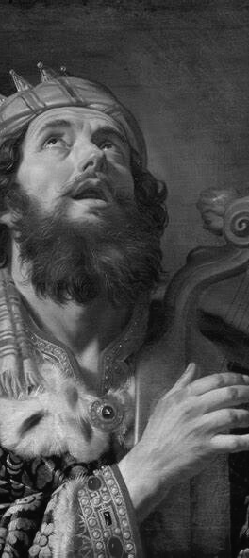
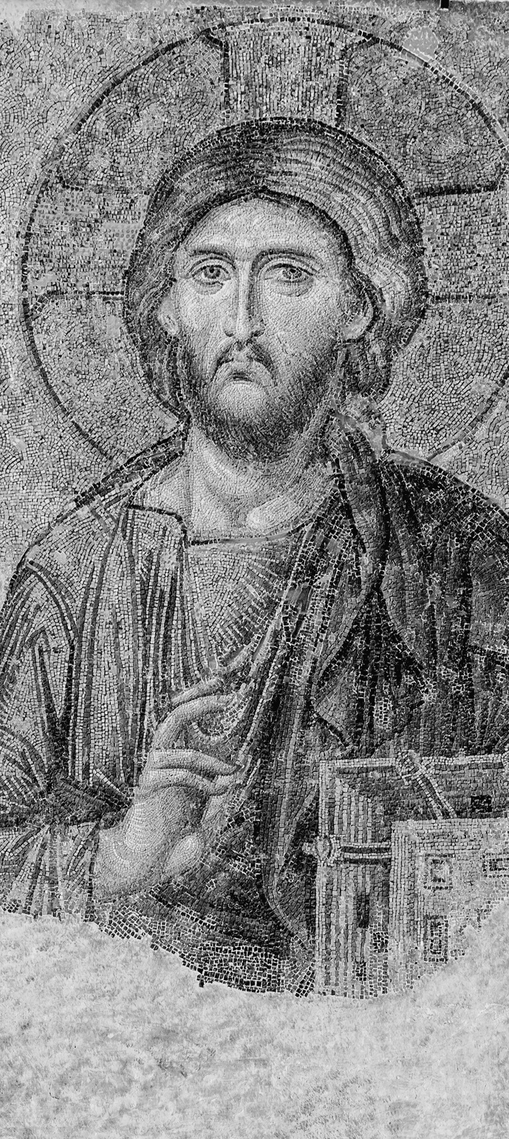
HOW CAN I TRUST IN GOD?
KNOW HOW THIS ENDS
KNOW HOW THIS ENDS
TAKE HEART
TAKE HEART
CONSIDER YOUR LIFE
CONSIDER YOUR LIFE

Slide 7
Lament
Psalm 22
Trust
Psalm 23
Thanksgiving
Psalm 24
Trust

