Slide 1
SEEKING GOD WITH THE PSALTER
How Long,
O Lord?
Palmetto Church of Christ (Summer 2020)

Slide 2
What do we pray about?

Slide 3
HONEST
Complaint
in the Psalms?
OPEN
REVERENT
Seeking God in the Psalter | Palmetto Church of Christ

Slide 4
MUST I TAKE COUNSEL IN MY SOUL AND HAVE SORROW IN MY HEART ALL THE DAY?
WILL YOU FORGET ME FOREVER?
How long, O LORD?
WILL YOU HIDE YOUR FACE FROM ME?
SHALL MY ENEMY BE EXALTED OVER ME?

Slide 5
LEST MY ENEMY SAY 'I HAVE PREVAILED!' LEST MY FOES REJOICE BECAUSE I AM SHAKEN
O LORD MY GOD!
LIGHT UP MY EYES, LEST I SLEEP THE SLEEP OF DEATH
Consider me, and answer!
Psalm 13.3
Psalm 13.4

Slide 6
I HAVE TRUSTED IN YOUR LOVE, MY HEART SHALL REJOICE IN YOUR SALVATION
I WILL SING TO THE LORD, BECAUSE HE HAS DEALT BOUNTIFULLY WITH ME
Psalm 13
Psalm 13.6
Psalm 13.5

Slide 7
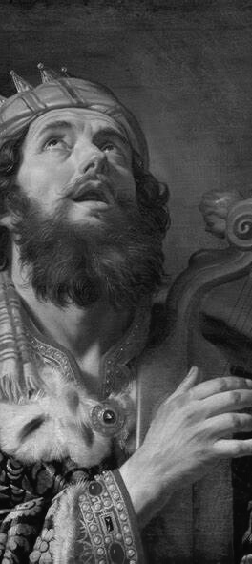
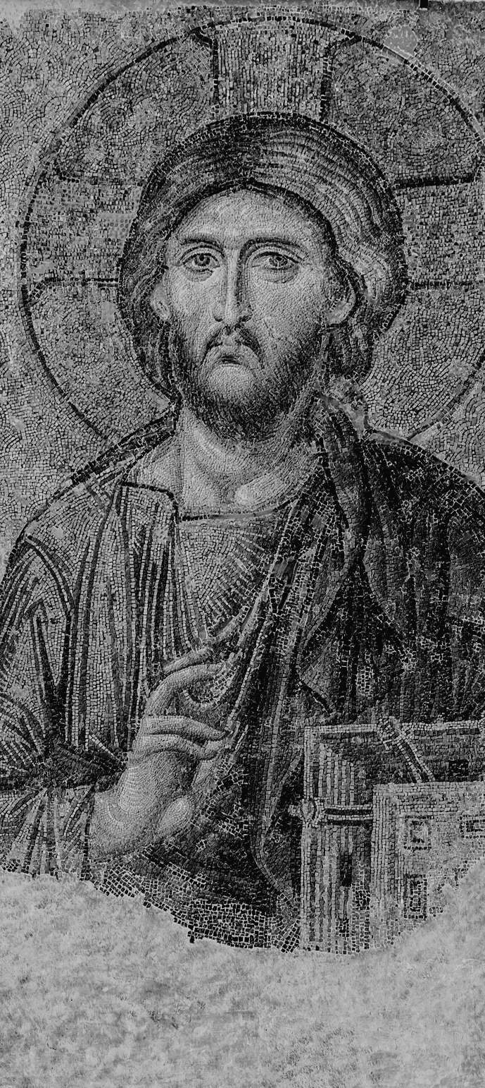
SEEK
GOD'S FACE
COMPLAIN
CONTEMPLATE
COMMUNE
COMPLAIN
CONTEMPLATE
COMMUNE

