Slide 1
PALMETTO CHURCH OF CHRIST (SUMMER 2020)
Partakers of the Divine Nature
2 Peter and Jude

Slide 2
AUTHORSHIP
AUDIENCE
Who wrote it?
To whom was it written?

Slide 3
Authorship: Weighing the Evidence
Internal Evidence
External Evidence
Weighing the Evidence
What is in the Bible itself: its words, its concepts, its language, its style
What's outside the Bible: what the early church says, what history says, what other authors say
How do we interpret what we've got? What do we think is stronger?
Palmetto Church of Christ | Summer 2020

Slide 4
ANCIENT TESTIMONY
THE EARLIEST DISCUSSION OF 2 PETER
Origen (AD 185–254)
Eusebius (AD 260–340)
Jerome (AD 327–420)
But Peter, upon whom the church of Christ is built, against which the gates of hell shall not prevail, has left one epistle undisputed. Suppose, also, the second was left by him for on this there is some doubt.
One of Peter's epistles (called "first") is acknowledged as genuine... But that which is called the second, we have not, indeed, understood to be embodied with the sacred books, yet as it appeared useful to many, it was studiously read with the other writings.
Also we see that the two epistles attributed to Saint Peter have different styles and turn phrases differently, by which it is discerned that it was sometimes necessary for him to use different interpreters.
Palmetto Church of Christ | 2020

Slide 5
What are our Options?
Peter Wrote It!
Peter Didn't Write It!
Peter Preached It!
None of the problems are proof Peter couldn't have written the epistle
None of evidences are proof Peter did write the epistles
What if... both were true?
Palmetto Church of Christ | 2020

Slide 6
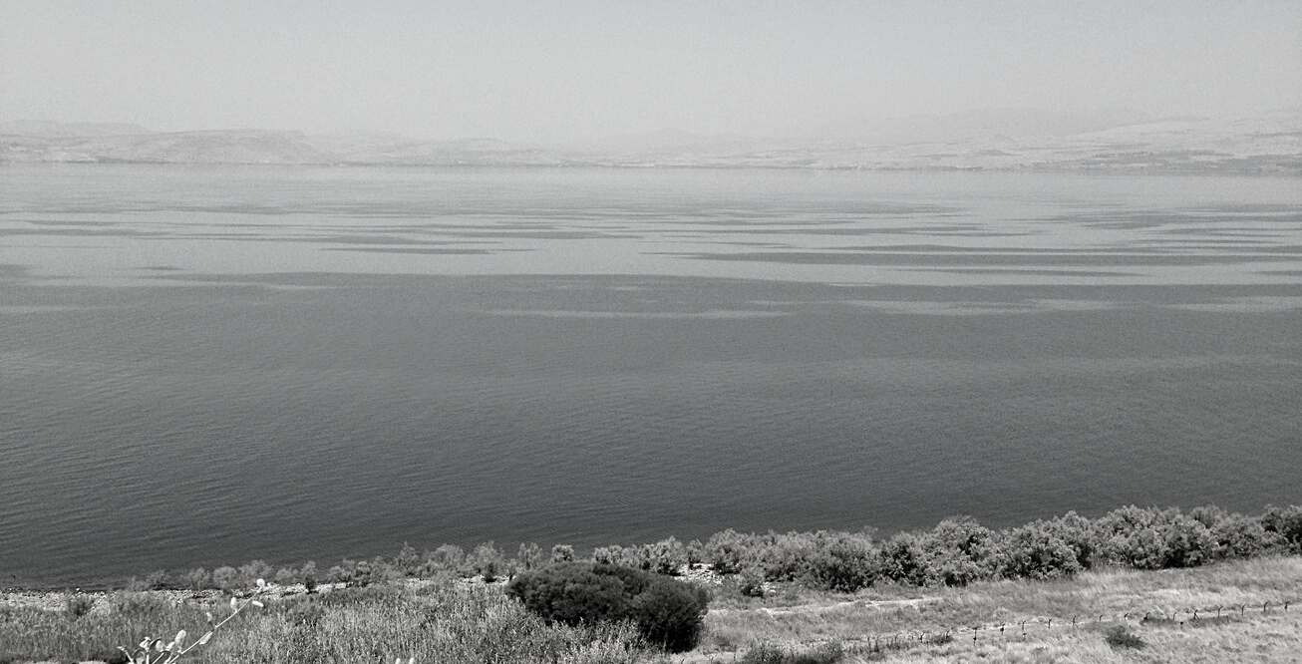
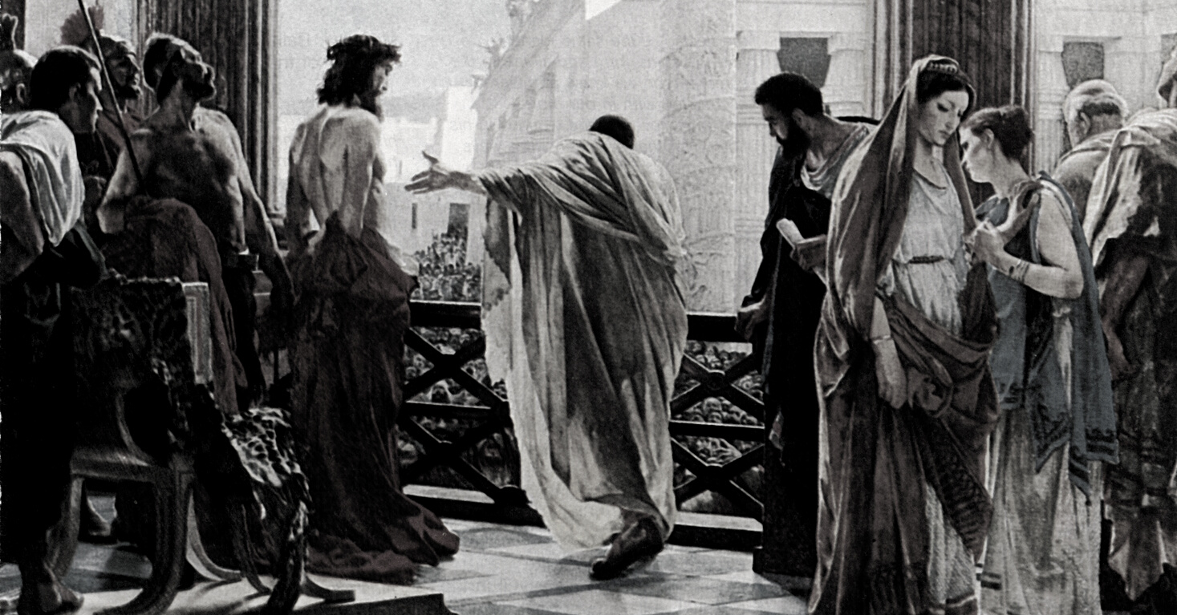
TRANSFIGURATION (LUKE 9)
CALLING (LUKE 5.1–11)
We were eyewitnesses to his majesty when he received honor and glory from God the Father and the voice was born to him by the Majestic Glory, 'This is my beloved son!' (2 Pet 1.16–18)
Therefore, brothers, be all the more diligent to confirm your calling and election (2 Pet 1.10)
DENIAL & LOVE (JOHN 18; 21)
JEWS & GENTILES (ACTS 10–15)
There will be false teachers among you, who secretly bring in destructive heresies, even denying the Master who bought them... (2 Pet 2.1)
Just as our beloved brother Paul also wrote to you according to the wisdom given to him, even has he does in all his letters when he speaks in them of these matters (2 Pet 3.15–16)
Palmetto Church of Christ | 2020

Slide 7
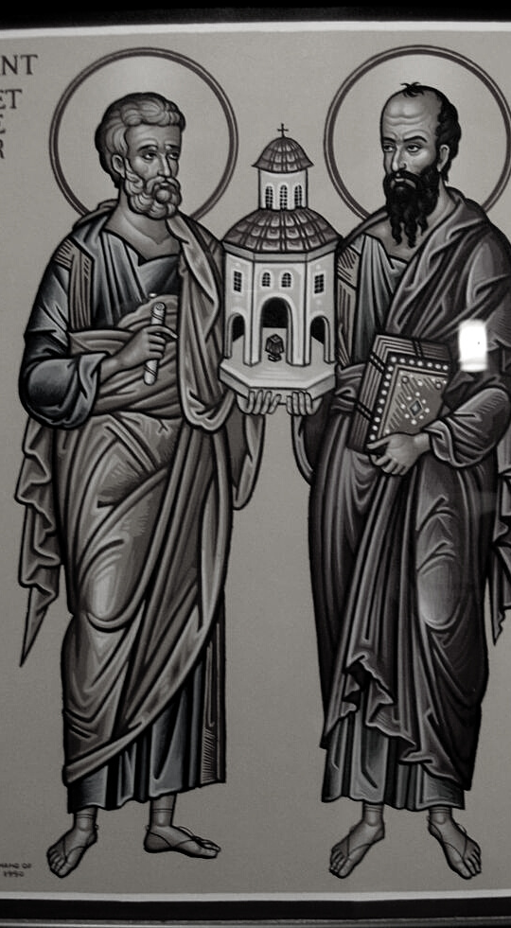
WHO'S THE AUDIENCE?
1 PETER 1.1
To those who are elect exiles of the Dispersion in Pontus, Galatia, Cappadocia, Asia, and Bithynia
WHO'S THE AUDIENCE?
2 PETER 1.1
To those who have obtained a faith of equal standing with ours by the righteousness of our God and Savior Jesus Christ
ARE THEY THE SAME?

Slide 8
GNOSTICISM?
Believed the Universe was controlled by an Evil Power who attempted to keep you from seeing the real rulers so that you wouldn't rebel against his authority.
EPICUREANISM?
Rejected God's providential care, the presence of an afterlife, the judgment, or a future change.
Palmetto Church of Christ | 2020

Slide 9
WHAT IS GNOSTICISM?
SEPARATES GOD FROM MAN AND GOD FROM HIS CREATION
God vs. the Archons
Immaterial vs. Material
Salvation through knowledge
Morality through knowledge

Slide 10
WHY GNOSTICISM?
WHAT DO "THEY" TEACH?
Deny the Lordship of Jesus (2.1)
Teach libertine immorality (2.10, 12, 18)
Despise authority (church & angels) (2.1)
Deny the Parousia (3.1–11)

Slide 11
WHAT IS EPICUREANISM?
DENIES GOD'S PROVIDENCE AND LAUDS PLEASURE ON EARTH
God vs. Humanity
Purely material
Salvation on earth
Morality through pleasure

Slide 12
WHY EPICUREANISM?
WHAT DO "THEY" TEACH?
Libertine immorality (2.10, 12, 18)
Deny the Parousia (3.1–11)
The "Anti-Judaism" (mAvot 2.9; mSanh 10.1; MmSanh 10.1)
Similar to Plutarch, On the Delay of Divine Vengeance

Slide 13
It might be easier to suggest that there were no precise opponents because 2 Peter was written to no precise church. It was written to counter a wide range of competing philosophical positions, heresies, and deviant practices that emerged, confusingly and sometimes seductively, within the religious milieu of the time.
-Michael Bird and N.T. Wright, 767

Slide 14
Greeting
(1.1–2)
STRUCTURE
Exhortation to confirm one's election
(1.3–11)
AND SUMMARY
Exhortation to remember apostolic instruction (1.12–15)
Validation of apostolic instruction
(1.16–21)
Warning of coming human destruction
(2.1–22)
Warning of coming divine destruction
(3.1–13)
Validation of apostolic instruction
(1.16–21)

Slide 15
NEXT CLASS
2 Peter 1.1–11
Begin the text!

