Slide 1
PALMETTO CHURCH OF CHRIST (SUMMER 2020)
Partakers of the Divine Nature
2 Peter and Jude

Slide 2
AUTHORSHIP
AUDIENCE
Who wrote it?
To whom was it written?

Slide 3
Authorship: Weighing the Evidence
Internal Evidence
External Evidence
Weighing the Evidence
What is in the Bible itself: its words, its concepts, its language, its style
What's outside the Bible: what the early church says, what history says, what other authors say
How do we interpret what we've got? What do we think is stronger?
Palmetto Church of Christ | Summer 2020

Slide 4
Authorship of 2 Peter: Internal Evidence
Vocabulary
Style
1 Peter & Jude
2 Peter
It's weird.
57 words != NT
~30 words != LXX
~30 words != Jewish
It's weird.
Attic Style?
Asiatic Style?*
It's weird.
Some similarities
Some differences
It's weird.
Simeon Peter (1.1)
Second letter (3.1)
Your apostles (3.2)
The fathers (3.4)
Paul's letters (3.15)
Palmetto Church of Christ

Slide 5
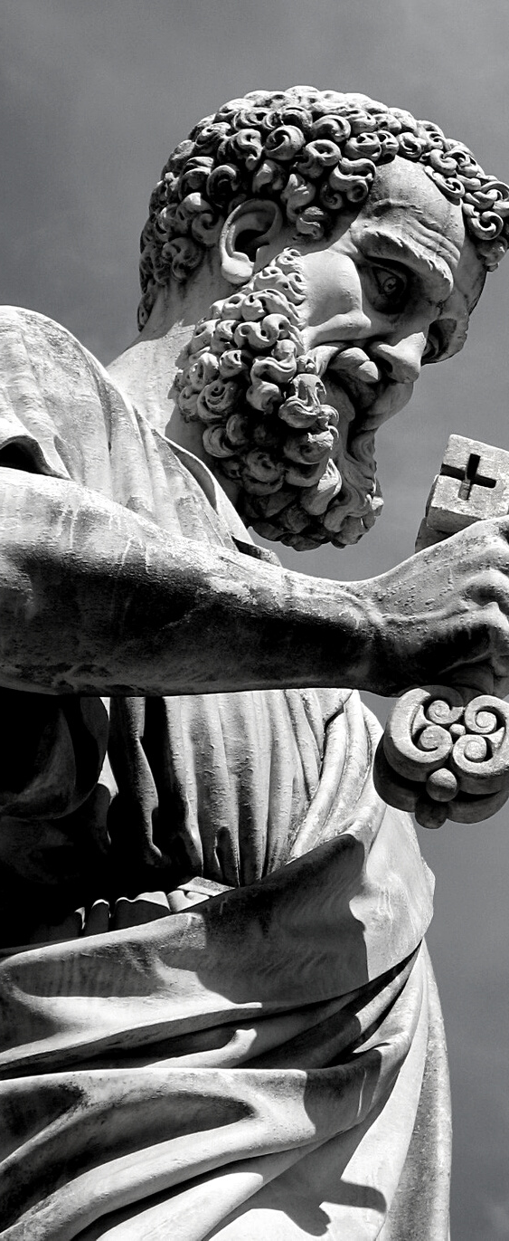
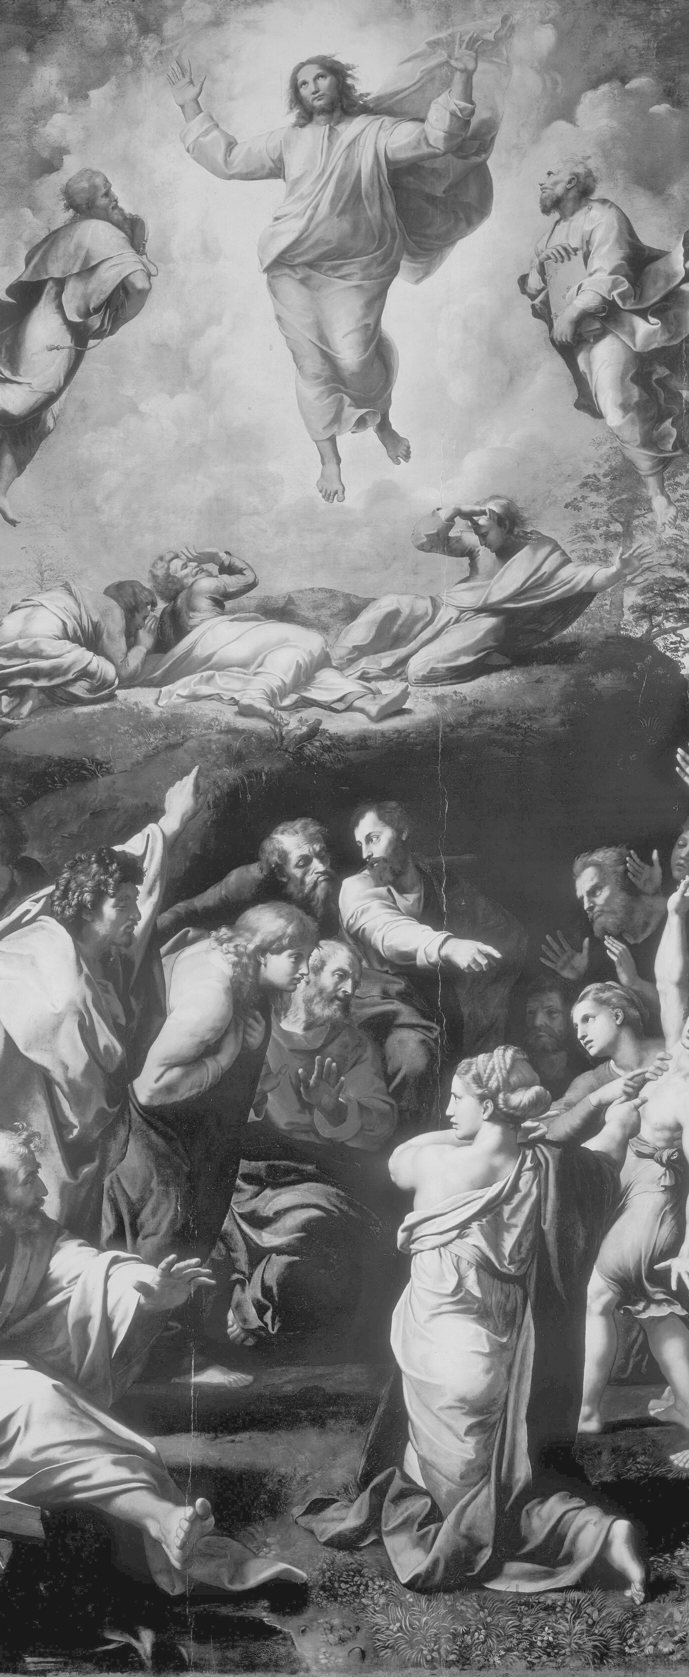
SO WHAT, THEN?
“That there is a weighty case against the apostolic authorship of 2 Peter it would be idle to deny. Its style, diction, poor attestation, relationship with Jude, as well as its idiosyncrasies of content make one inclined to assign it to the second century….” -Michael Green, 2 Peter (Tyndale), 30

Slide 6
Authorship of 2 Peter: External Evidence
Church Fathers
It's weird.
Origen (3rd cent)
Eusebius (4th cent)
Jerome (4th cent)
Palmetto Church of Christ

Slide 7
ANCIENT TESTIMONY
THE EARLIEST DISCUSSION OF 2 PETER
Origen (AD 185–254)
Eusebius (AD 260–340)
Jerome (AD 327–420)
But Peter, upon whom the church of Christ is built, against which the gates of hell shall not prevail, has left one epistle undisputed. Suppose, also, the second was left by him for on this there is some doubt.
One of Peter's epistles (called "first") is acknowledged as genuine... But that which is called the second, we have not, indeed, understood to be embodied with the sacred books, yet as it appeared useful to many, it was studiously read with the other writings.
Also we see that the two epistles attributed to Saint Peter have different styles and turn phrases differently, by which it is discerned that it was sometimes necessary for him to use different interpreters.
Palmetto Church of Christ | 2020

Slide 8
Authorship of 2 Peter: External Evidence
Church Fathers
External Testimony
Earlier Interpreters
Historical Markers
It's weird.
Origen (3rd cent)
Eusebius (4th cent)
Jerome (4th cent)
It's weird.
Early use
Canonical acceptance
It's weird.
Erasmus
Luther
Calvin
It's not weird.
Gnosticism
Montanism
Millennialism
Church Structures
Parousia
Palmetto Church of Christ

Slide 9
What are our Options?
Peter Wrote It!
Peter Didn't Write It!
Peter Preached It!
None of the problems are proof Peter couldn't have written the epistle
None of evidences are proof Peter did write the epistles
What if... both were true?
Palmetto Church of Christ | 2020

Slide 10
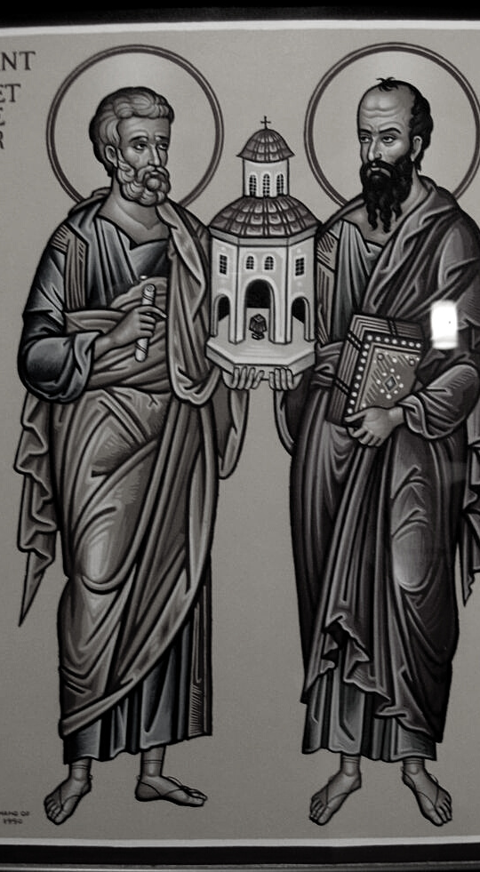
WHO'S THE AUDIENCE?
1 PETER 1.1
To those who are elect exiles of the Dispersion in Pontus, Galatia, Cappadocia, Asia, and Bithynia
WHO'S THE AUDIENCE?
2 PETER 1.1
To those who have obtained a faith of equal standing with ours by the righteousness of our God and Savior Jesus Christ
ARE THEY THE SAME?

Slide 11
GNOSTICISM?
Believed the Universe was controlled by an Evil Power who attempted to keep you from seeing the real rulers so that you wouldn't rebel against his authority.
EPICUREANISM?
Rejected God's providential care, the presence of an afterlife, the judgment, or a future change.
Palmetto Church of Christ | 2020

Slide 12
NEXT CLASS
2 Peter 1.1–11
Will talk more about Peter's personal history, the hellenistic background to the letter, and introduce the beginning of the epistle.

